Slide 1
Ministry/ Organization name: Central Ground Water Board, Ministry of Jal Shakti Problem Statement : Data analytics to provide complete solution for groundwater management for the country Team Name : Eff-Yuu Team Leader Name : Shubham Bhandari College Code : U0657 Mentors : Dr. Alok Kumar, Dr. Kedar Sharma

Slide 2
Problem Description
Groundwater is the major source of freshwater for drinking, irrigation and industrial purposes and has always been a hidden treasure because of its dynamic nature. The health of the groundwater system is reflected in the groundwater levels of the region. There is a need to develop a robust application to understand the groundwater scenario and its resources of the regions. Representative groundwater level data needs to be analysed using statistical and arithmetical solutions along with the groundwater resources of the country to identify the blocks/district/state which has been critical compared to previous decade.

Slide 3



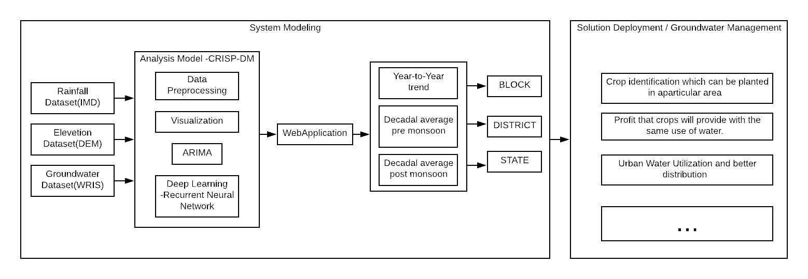


Idea / Approach details

Slide 4
Technology stack
Python : Running statistical and arithmetical models
Kepler.gl, plot.ly : Data Visualization
Django: Web Application

Slide 5
Use Cases
Crop identification which can be planted in a particular area
Profit that crops will provide with the same use of water.
Urban Water Utilization and better distribution

Slide 6

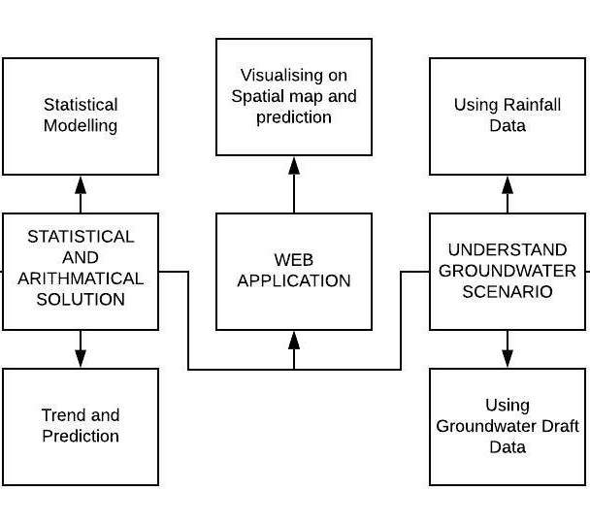
Dependencies / Show stopper

